Slide 1
Naïve Bayes Classifier ML ALGORITHM Python

Slide 2
Naive Bayes Classifier
A naive Bayes classifier is a simple probabilistic classifier based on Bayes' theorem.
It can be used as an alternative method to Logistic Regression
It is particularly suited when the dimensionality of the inputs is high. Despite its simplicity, Naive Bayes can often outperform more sophisticated classification methods.

Slide 3

Bayes Theorem
Where
P(A) is the prior probability or marginal probability of A.
P(A|B) is the conditional probability of A, given B.
P(B|A) is the conditional probability of B given A.
P(B) is the prior or marginal probability of B.

Slide 4
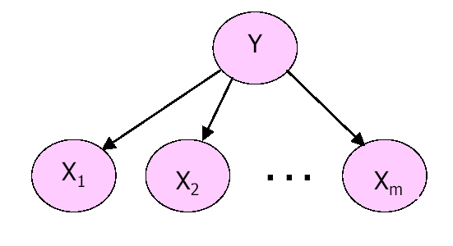
Naïve Bayes Framework
Y : Categorical Dependent Variable
Xi : Categorical/Continuous Independent Variable
Objective: To estimate Y given the values of Xi’s or
P(Y|X1 X2 ….Xm) using the Naïve Bayes Classifier.
Assumption: All Xi’s are conditionally independent of each other.

Slide 5
Example
Consider a simple example where dependent variable Y is binary variable and there are 2 independent
variables X1 and X2.
We classify Y = 1 as potential buyer of a certain product
Y = 0 otherwise
Let X1 denote age of the individual
X1 = 0 for age group 25-30 yrs.
= 1 for age group 31-40 yrs.
Let X2 denote gender
X2 = 0 if Gender=female
= 1 if Gender=male

Slide 6
Classification Rule
For the given values of age(X1)and gender(X2), we want to classify the customer as potential buyer or not.
Using Naïve Bayes Classifier we estimate following 2 conditional probabilities:
P(Y=0/X1=a1, X2=a2) and P(Y=1/X1=a1,X2=a2);
here a1 and a2 are values of X1 and X2 for a particular customer.
We classify Y = 0 if P(Y=0/X1=a1, X2=a2) > 0.5
OR Y = 1 if P(Y=1/X1=a1,X2=a2) > 0.5

Slide 7
Expected Output
Once the classification rule is applied the output can be shown as follows:
Case# | X1 | X2 | P(Y=1/X1,X2) | P(Y=0/X1,X2) | Y classified as
1 2 240 | 1 1 0 | 0 1 0 | 0.29 0.65 0.51 | 0.71 0.35 0.49 | 0 1 1

Slide 8
Case Study – Modeling Loan Defaults
Background
Objective
Available Information
A bank possesses demographic and transactional data of its loan customers. If the bank has a model to predict defaulters it can help in loan disbursal decision making.
To predict whether the customer applying for the loan will be a defaulter or not.
Independent Variables: Age group, Years at current address, Years at current employer, Debt to Income Ratio, Credit Card Debts, Other Debts. The information on predictors was collected at the time of loan application process.
Sample size is 700
Dependent Variable: Defaulter (=1 if defaulter ,0 otherwise). The status is observed after loan is disbursed.

Slide 9
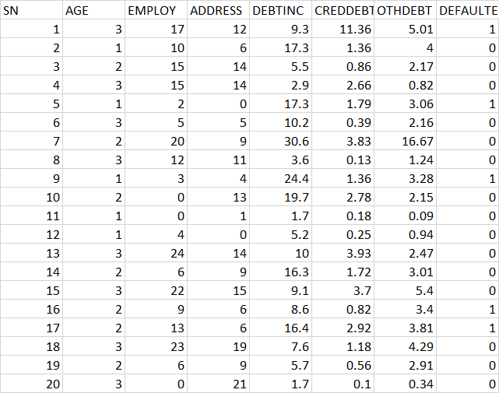
Data Snapshot
Independent Variables
Dependent Variable
Column | Description | Type | Measurement | Possible Values
SN | Serial Number | numeric | - | -
AGE | Age Groups | Integer | 1(<28 years), 2(28-40 years), 3(>40 years) | 3
EMPLOY | Number of years customer working at current employer | Integer | - | Positive value
ADDRESS | Number of years customer staying at current address | Integer | - | Positive value
DEBTINC | Debt to Income Ratio | Continuous | - | Positive value
CREDDEBT | Credit to Debit Ratio | Continuous | - | Positive value
OTHDEBT | Other Debt | Continuous | - | Positive value
DEFAULTER | Whether customer defaulted on loan | Integer | 1(Defaulter), 0(Non-Defaulter) | 2
Observations

Slide 10
Naive Bayes Method in Python
# Importing required Libraries
import pandas as pd import numpy as np import matplotlib.pyplot as plt from sklearn.model_selection import train_test_split from sklearn.preprocessing import StandardScaler from sklearn.naive_bayes import GaussianNB, MultinomialNB from sklearn.metrics import confusion_matrix, f1_score, precision_score, recall_score, accuracy_score, roc_curve, roc_auc_score
Naive Bayes methods differ based on the type of predictors- continuous or categorical
Python’s sklearn has various methods available and the two methods explored hereon are Gaussian Naive Bayes and Multinomial Naive Bayes.

Slide 11
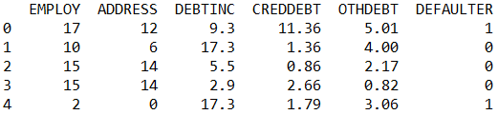
Naive Bayes Method in Python For Continuous Predictors
# Importing and Readying the Data for Modeling
bankloan = pd.read_csv("BANK LOAN.csv") bankloan1 = bankloan.drop(['SN','AGE'], axis = 1) bankloan1.head()
drop() is used to remove unwanted variables. AGE is removed because it is a categorical variable.
axis = 1 drops columns.
# Output

Slide 12
Naive Bayes Method in Python For Continuous Predictors
# Creating Train and Test Data Sets
X = bankloan1.loc[:,bankloan1.columns != 'DEFAULTER'] y = bankloan1.loc[:, 'DEFAULTER'] X_train, X_test, y_train, y_test = train_test_split(X, y, test_size=0.30, random_state = 999)
train_test_split() from sklearn.model_selection is used to split dataset into random train and test sets.
test_size represents the proportion of dataset to be included in the test set.
random_state sets the seed for the random number generator.

Slide 13
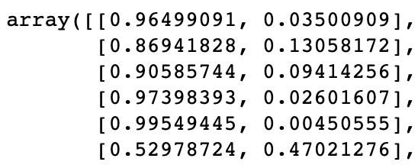
Naive Bayes Method in Python For Continuous Predictors
# Model Fitting
GaussianNB() fits a Gaussian Naive Bayes algorithm for classification.
This model is suitable for continuous predictors and assumes the likelihood of predictors to be normal.
NBmodel = GaussianNB() NBmodel.fit(X_train, y_train)
# Predicted Probabilities
predprob_test = NBmodel.predict_proba(X_test) predprob_test
predict_proba() returns predicted probabilities for the test data.
# Output

Slide 14
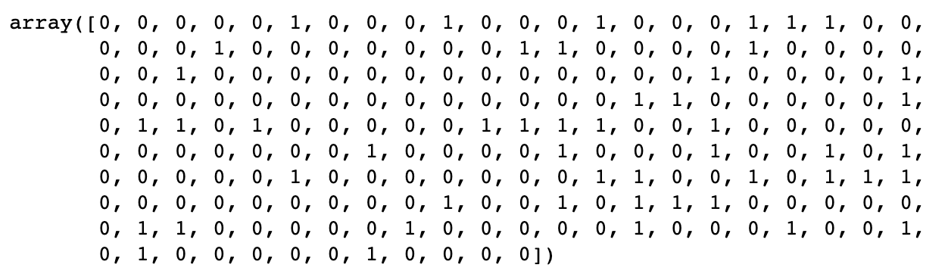
Naive Bayes Method in Python For Continuous Predictors
# Custom Cutoff Value for Prediction Labels
cutoff = 0.3 pred_test = np.where(predprob_test[:,1] > cutoff, 1, 0) pred_test
The output is an array of binary labels.
# Output

Slide 15
Naive Bayes Method in Python For Continuous Predictors
# Confusion Matrix
confusion_matrix(y_test, pred_test, labels=[0, 1]) array([[135, 22], [ 26, 27]])
accuracy_score(y_test, pred_test) 0.7714285714285715
precision_score(y_test, pred_test) 0.5510204081632653
recall_score(y_test, pred_test) 0.5094339622641509
accuracy_score() = number of correct predictions out of total predictions
precision_score() = true positives / (true positives + false positives)
recall_score() also known as ‘Sensitivity’ = true positives / (true positives + false negatives)
# Area Under ROC Curve
auc = roc_auc_score(y_test, predprob_test[:,1]) print('AUC: %.3f' % auc) AUC: 0.816
roc_auc_score computes Area Under the ROC curve.
*
Note : Output will be slightly different as observations are randomly assigned to train-test data.

Slide 16
Naive Bayes Method in Python For Continuous Predictors
# ROC Curve
NBfpr, NBtpr, thresholds = roc_curve(y_test, predprob_test[:,1]) # plot the roc curve for the model plt.figure() lw = 2 plt.plot(NBfpr, NBtpr, color='darkorange',lw=lw, label='ROC curve (area = %0.3f)' % auc) plt.plot([0, 1], [0, 1], color='navy', lw=lw, linestyle='--') plt.axis('tight') plt.xlabel('False Positive Rate');plt.ylabel('True Positive Rate') plt.title('Receiver operating characteristic’) plt.legend(loc="lower right") plt.show()
roc_curve is used to Compute Receiver operating characteristic.

Slide 17
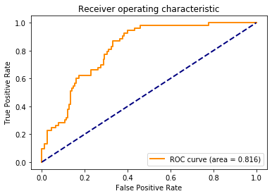
Naive Bayes Method in Python For Continuous Predictors
# Output:

Slide 18
Case Study – Employee Churn Model
Background
Objective
Available Information
A company has comprehensive database of its past and present workforce, with information on their demographics, education, experience and hiring background as well as their work profile. The management wishes to see if this data can be used for predictive analysis, to control attrition levels.
To develop an Employee Churn model via Naive Bayes
Gender, Experience Level (<3, 3-5 and >5 years), Function (Marketing, Finance, Client Servicing (CS)) and Source (Internal or External) are independent variables
Status is the dependent variable (=1 if employee left within 18 months from joining date)
Sample size is 83

Slide 19
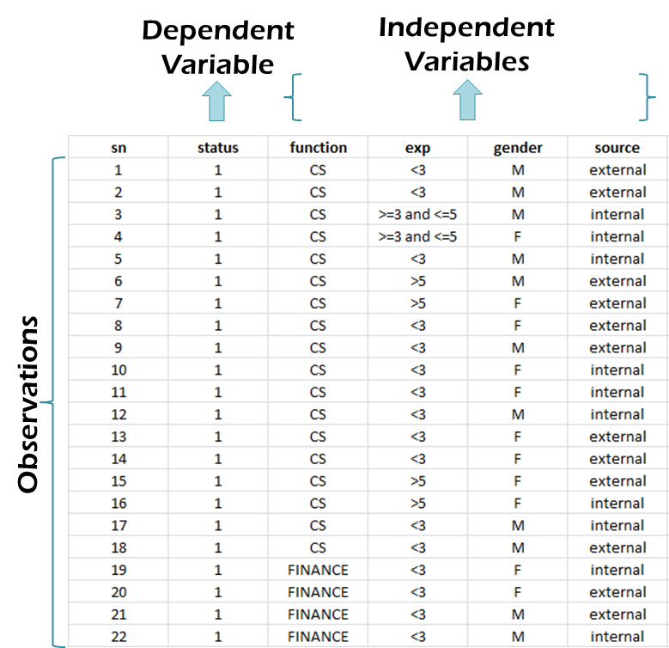
Data Snapshot
EMPLOYEE CHURN DATA
Columns | Description | Type | Measurement | Possible values
sn | Serial Number | Integer | - | -
status | = 1 If the Employee Left Within 18 Months of Joining = 0 Otherwise | Integer | 1,0 | 2
function | Employee Job Profile | Character | CS, FINANCE, MARKETING | 3
exp | Experience in Years | Character | <3,3-5,>5 | 3
gender | Gender of the Employee | Character | M,F | 2
source | Whether the Employee was Appointed via Internal or External Links | Character | external, internal | 2

Slide 20
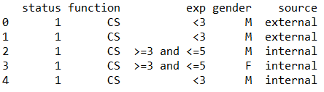
Naive Bayes Method in Python For Categorical Predictors
# Importing and Readying the Data for Modeling, Model Fitting
empdata = pd.read_csv("EMPLOYEE CHURN DATA.csv") empdata1 = empdata.loc[:, empdata.columns != 'sn'] empdata1.head()
loc() is used to create a subset of the data frame using column name. Removing column with serial numbers.
# Output

Slide 21
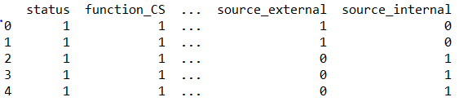
Naive Bayes Method in Python For Categorical Predictors
# Creating Dummy Variables
empdata2 = pd.get_dummies(empdata1) empdata2.head()
pd.get_dummies() converts categorical variables into dummy variables. This step is crucial because the naive Bayes function used for categorical variables requires this format.
# Output

Slide 22
Naive Bayes Method in Python For Categorical Predictors
# Creating Data Partitions
X_emp = empdata2.loc[:,empdata2.columns != 'status'] y_emp = empdata2.loc[:, 'status']
# Model Fitting
MNBmodel = MultinomialNB(alpha = 0) MNBmodel.fit(X_emp, y_emp)
MultinomialNB() fits a Multinomial Naive Bayes algorithm for classification. This model is suitable for categorical predictors.
alpha = 0 ensures the model doesn’t apply any smoothing on the data.

Slide 23
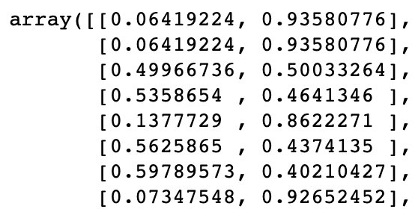
Naive Bayes Method in Python For Categorical Predictors
# Predicted Probabilities
predprob_MNB = MNBmodel.predict_proba(X_emp) predprob_MNB
# Output
# Custom Cutoff Value for Prediction Labels
cutoff = 0.3 pred_test = np.where(predprob_MNB[:,1] > cutoff, 1, 0)

Slide 24
Naive Bayes Method in Python For Categorical Predictors
# Confusion Matrix
confusion_matrix(y_emp, pred_test, labels=[0, 1]) array([[37, 13], [ 3, 30]])
accuracy_score(y_emp, pred_test) 0.8072289156626506
precision_score(y_emp, pred_test) 0.6976744186046512
recall_score(y_emp, pred_test) 0.9090909090909091
accuracy_score() = number of correct predictions out of total predictions
precision_score() = true positives / (true positives + false positives)
recall_score() also known as ‘Sensitivity’ = true positives / (true positives + false negatives)
# Area Under ROC Curve
auc = roc_auc_score(y_emp, predprob_MNB[:,1]) print('AUC: %.3f' % auc) AUC: 0.871
*
Note : Output might be slightly different as observations are randomly assigned to train-test data.

Slide 25
Naive Bayes Method in Python For Categorical Predictors
# ROC Curve
MNBfpr, MNBtpr, thresholds = roc_curve(y_emp, predprob_MNB[:,1]) # plot the roc curve for the model plt.figure() lw = 2 plt.plot(MNBfpr, MNBtpr, color='darkorange',lw=lw, label='ROC curve (area = %0.3f)' % auc) plt.plot([0, 1], [0, 1], color='navy', lw=lw, linestyle='--') plt.axis('tight') plt.xlabel('False Positive Rate');plt.ylabel('True Positive Rate') plt.title('Receiver operating characteristic') plt.legend(loc="lower right") plt.show()

Slide 26
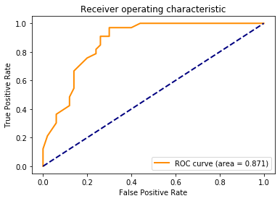
Naive Bayes Method in Python For Categorical Predictors
# Output

Slide 27
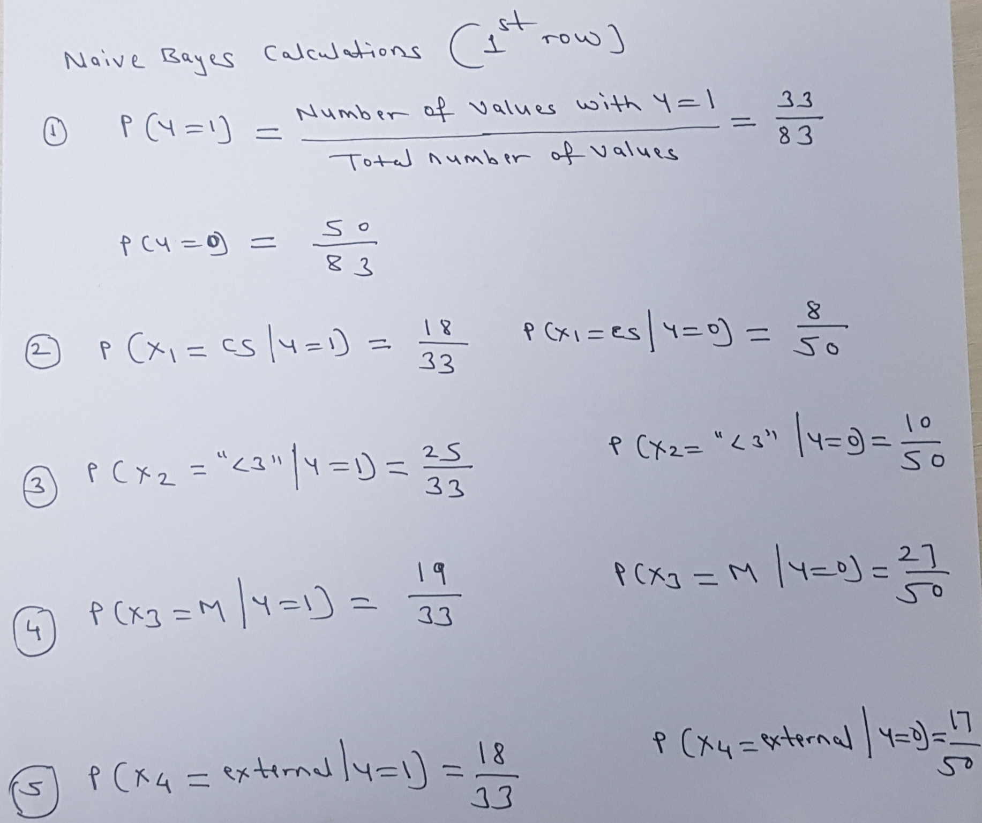
Predicted Probability for 1st Case

Slide 28
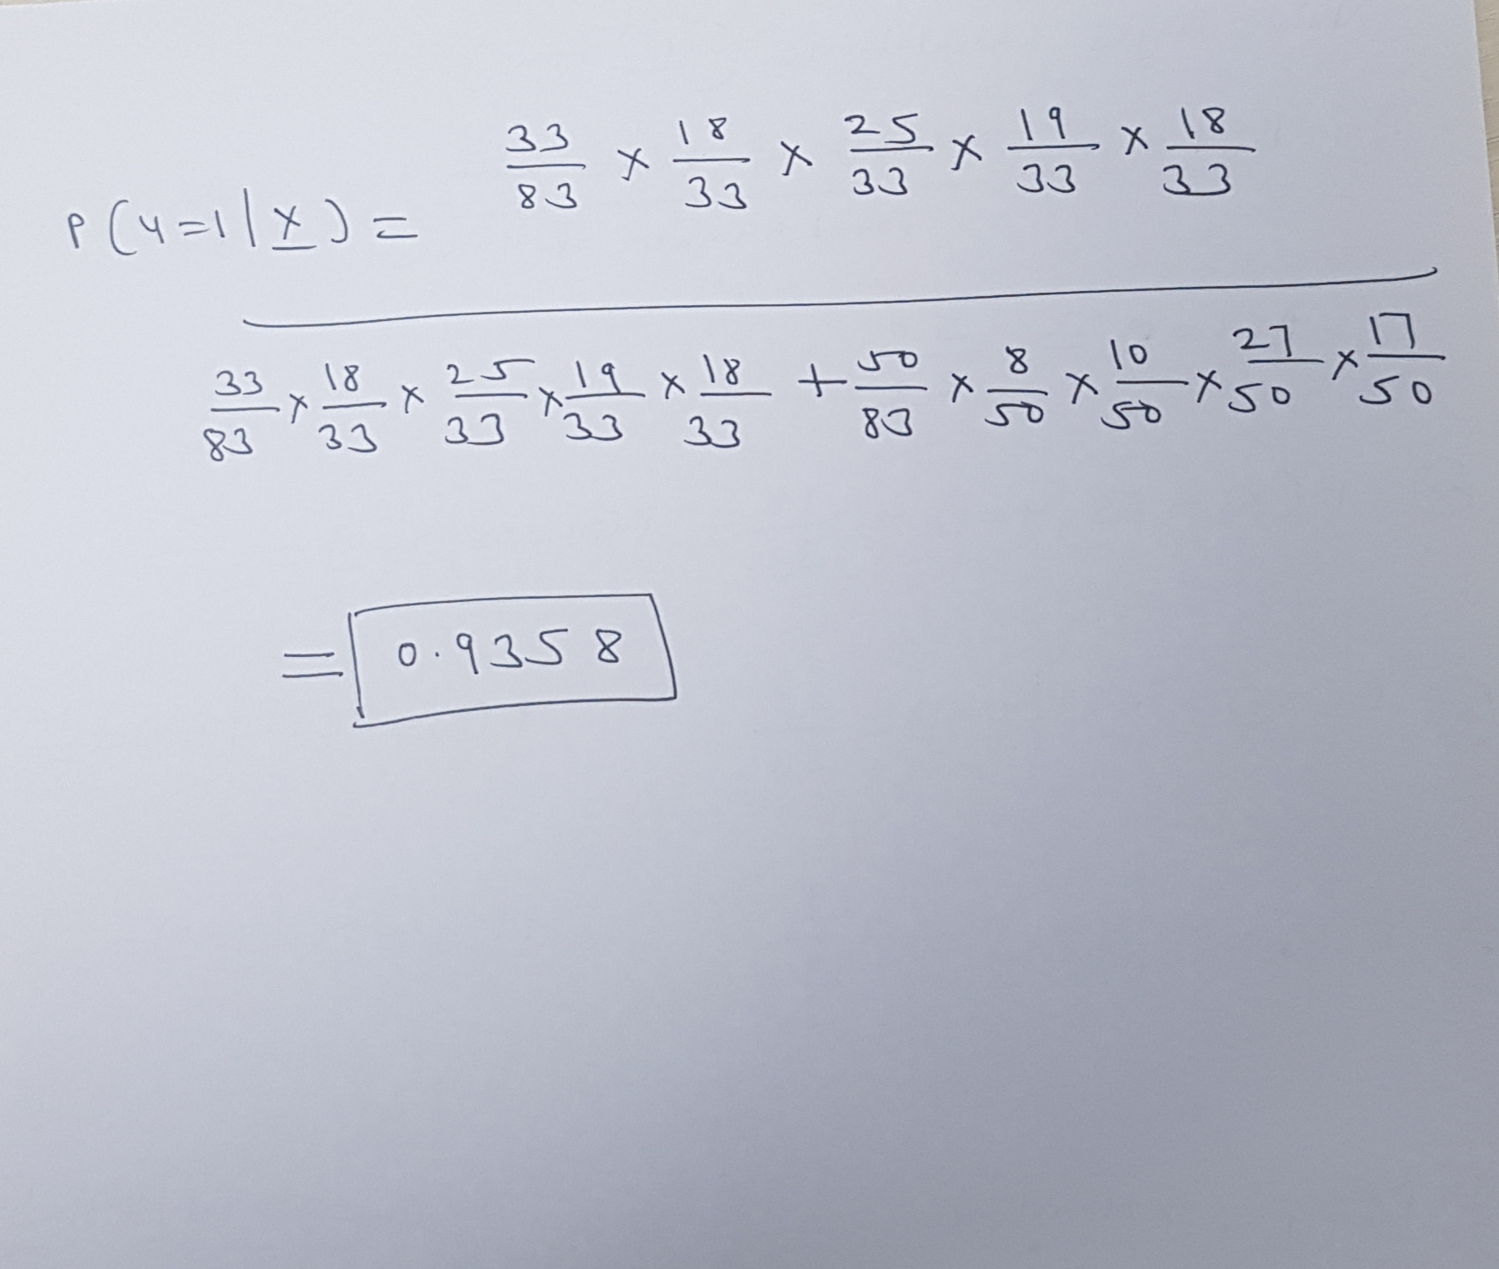
Predicted Probability for 1st Case

Slide 29

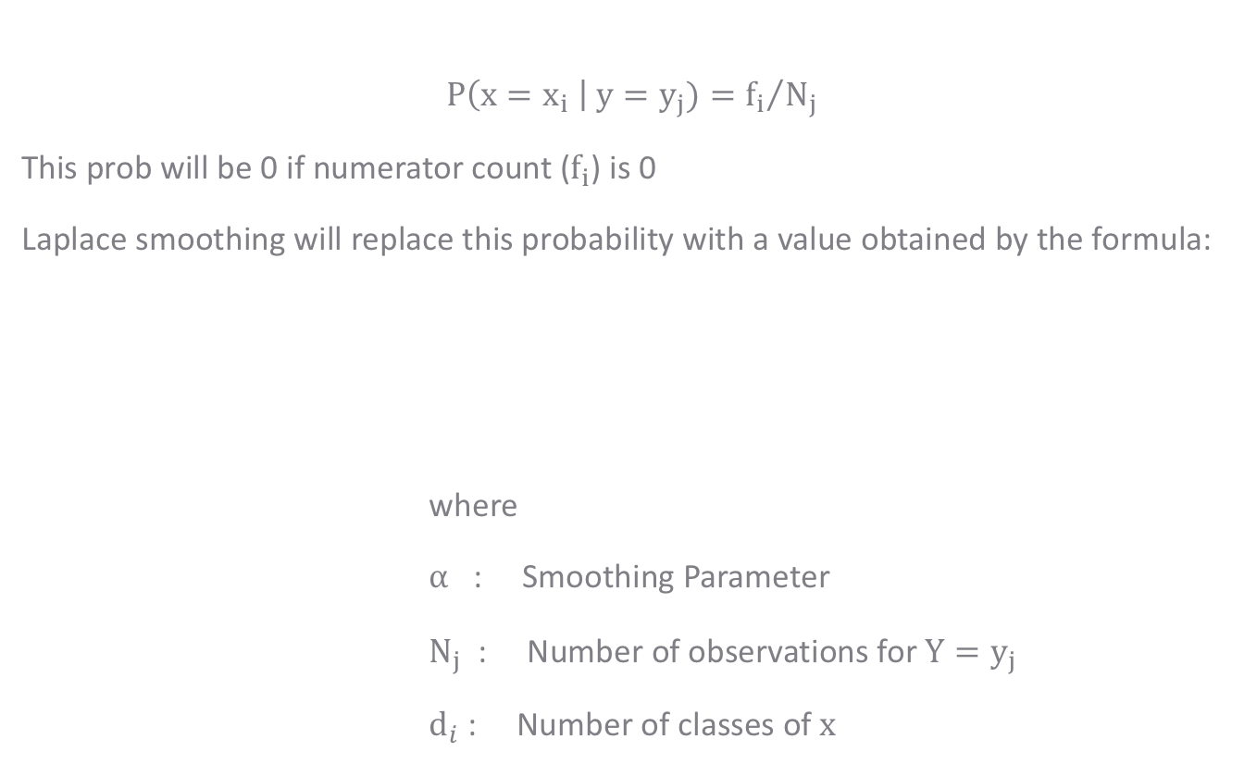
Laplace Smoothing
$$P\left(x=x_{i} \right| y=y_{j})={f_{i}}/{N_{j}}$$
This prob will be 0 if numerator count ($f_{i}$) is 0
Laplace smoothing will replace this probability with a value obtained by the formula:
where
$α$ : Smoothing Parameter
$N_{j}$ : Number of observations for ${Y=y}_{j}$
$d_{i}$ : Number of classes of$x$
$$\hat{θ}i=\frac{f_{i}+α}{N_{j}+αd_{i}}$$

Slide 30
Quick Recap
Naive Bayes in Python
GaussianNB for continuous variables, MultinomialNB for categorical variables in library sklearn.naive_bayes
Laplace Smoothing
If a given class and feature value never occur together in the training data, then the frequency-based probability estimate will be zero.
A pseudo-count is incorporated, in all probability estimates such that no probability is ever set to be exactly zero.
This way of regularizing naive Bayes is called Laplace Smoothing

Slide 31
THANK YOU!

Slide 32
THANK YOU!!

